Slide 1

Hotel Reservation Analysis with SQL
Yousef Khaled Shawkyy

Slide 2
15 question to gain insights.
1. What is the total number of reservations in the dataset?
2. Which meal plan is the most popular among guests?
3. What is the average price per room for reservations involving children?
4. How many reservations were made for the year 20XX (replace XX with the desired year)?
5. What is the most commonly booked room type?
6. How many reservations fall on a weekend (no_of_weekend_nights > 0)?
7. What is the highest and lowest lead time for reservations?
8. What is the most common market segment type for reservations?
9. How many reservations have a booking status of "Confirmed"?
10. What is the total number of adults and children across all reservations?
11. What is the average number of weekend nights for reservations involving children?
12. How many reservations were made in each month of the year?
13. What is the average number of nights (both weekend and weekday) spent by guests for each room
type?
14. For reservations involving children, what is the most common room type, and what is the average
price for that room type?
15. Find the market segment type that generates the highest average price per room.

Slide 3
Dataset Details
The dataset includes the following columns:
• Booking_ID: A unique identifier for each hotel reservation.
• no_of_adults: The number of adults in the reservation.
• no_of_children: The number of children in the reservation.
• no_of_weekend_nights: The number of nights in the reservation that fall on
weekends.
• no_of_week_nights: The number of nights in the reservation that fall on
weekdays.
• type_of_meal_plan: The meal plan chosen by the guests.
• room_type_reserved: The type of room reserved by the guests.
• lead_time: The number of days between booking and arrival.
• arrival_date: The date of arrival.
• market_segment_type: The market segment to which the reservation
belongs.
• avg_price_per_room: The average price per room in the reservation.
• booking_status: The status of the booking.

Slide 4
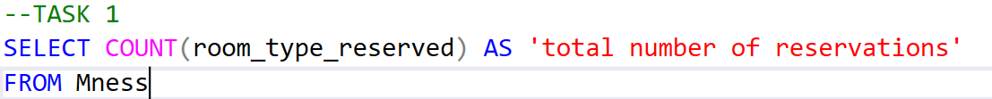
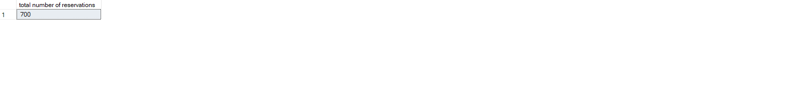
FIRST QUESTION
1. What is the total number of reservations in the dataset?
Using sql we wrote this code to see our total number of reservations
Then the total number of reservations is 700

Slide 5
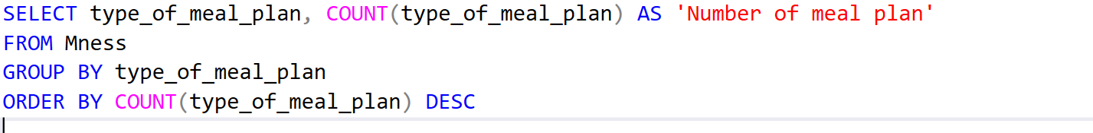
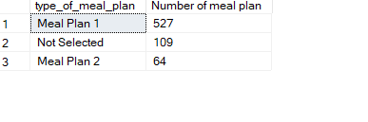
SECOND QUESTION
2. Which meal plan is the most popular among guests?
Using this code in sql we will display every meal plan with its count
the most popular and most chosen plan is meal plan 1.

Slide 6
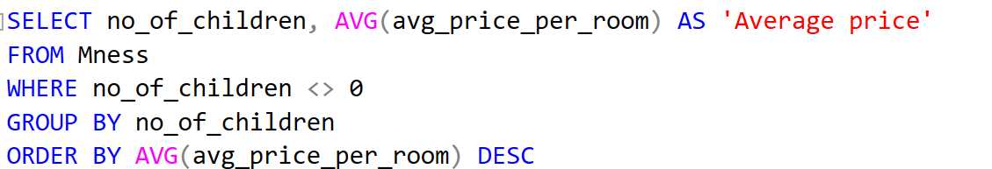
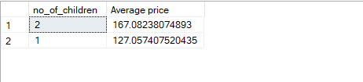
THIRD QUESTION
3. What is the average price per room for reservations involving children?
In this code we used a condition that the number of children is not equal to 0 like the question room must involve children.
Then the average for room that involves 2 children in room is 167.08
And the average for room that involves 1 children in room is 127.06

Slide 7
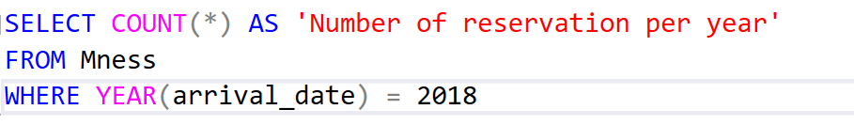
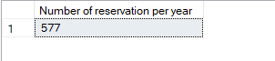
FOURTH QUESTION
4. How many reservations were made for the year 20XX (replace XX with the desired year)?
we used 2018 an example in this code, we solved this question with 2 solutions
We used if first solution where statement and we used the first day in the year and the last day in the year,
Second solution we used a function called year it is way better, the number of reservation per year for 2018 is 577

Slide 8
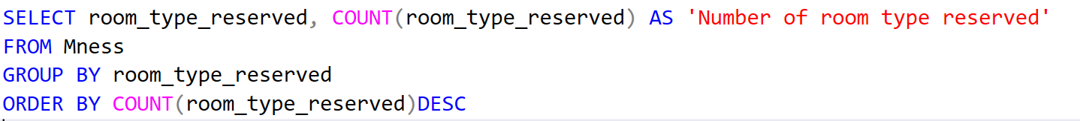
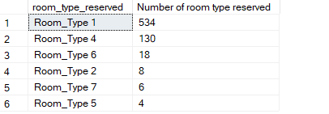
FIFTH QUESTION
What is the most commonly booked room type?
We used this code to see every room type and its count and we ordered it descending
Room type 1 is the most commonly booked room type.

Slide 9
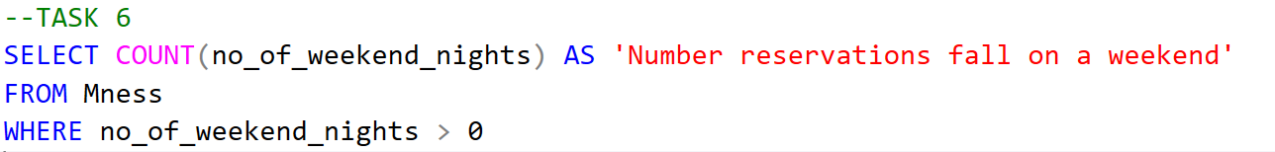
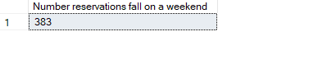
SIXTH QUESTION
How many reservations fall on a weekend (no_of_weekend_nights > 0)?
We selected from our database the count of weekend nights and we excepted the 0 value
The number of reservation is 383

Slide 10
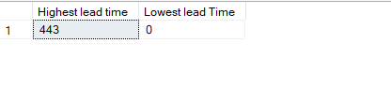
SEVENTH QUESTION
What is the highest and lowest lead time for reservations?
We selected from lead time the maximum value and the minimum value.
Then the highest lead time is 443 and the lowest lead time is 0

Slide 11
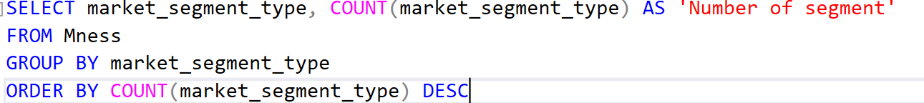
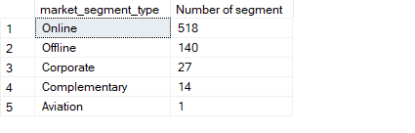
EIGHTH QUESTION
What is the most common market segment type for reservations?
We select the segment type and its count and we ordered it descending to see the most common market segment.
The most common market segment is online

Slide 12
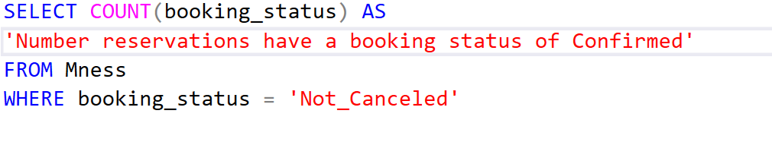
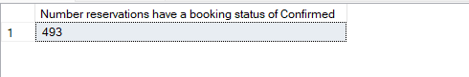
NINTH QUESTION
How many reservations have a booking status of "Confirmed"?
In our dataset there is canceled and not canceled
,Not canceled == to confirmed then we selected not canceled and its count in dataset
The number of confirmed status is 493

Slide 13
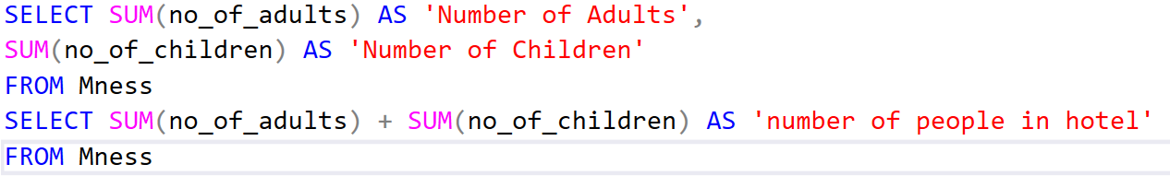
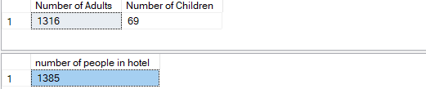
10TH QUESTION
What is the total number of adults and children across all reservations?
We selected the sum of the children and the sum of the adults from our data set and we added them to each other
The number of people in our hotel is 1385

Slide 14
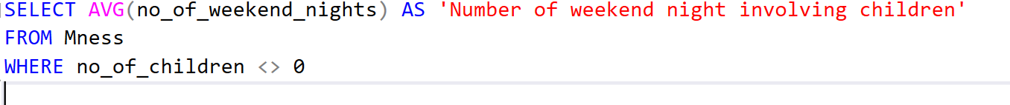
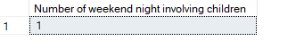
11TH QUESTION
What is the average number of weekend nights for reservations involving children?
We selected from our dataset the average number of weekend nights and we made a condition that the number of children is not equal to 0
The number of weekend involving children is 1

Slide 15
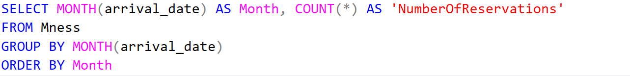
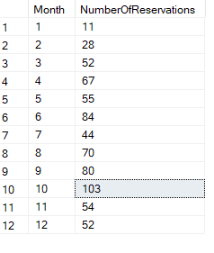
12TH QUESTION
How many reservations were made in each month of the year?
We used a function called month it to display every month with its count

Slide 16
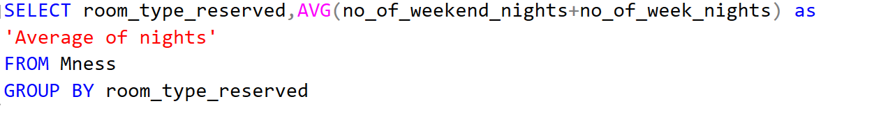
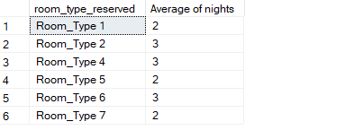
13TH QUESTION
What is the average number of nights (both weekend and weekday) spent by guests for each room type?
We selected each room type with its average number of nights

Slide 17
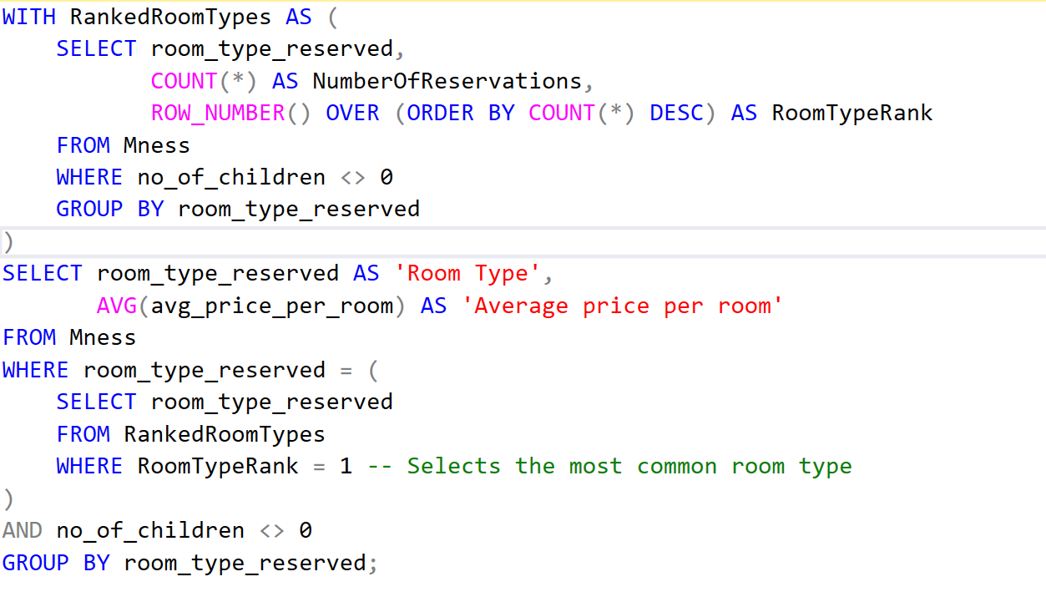
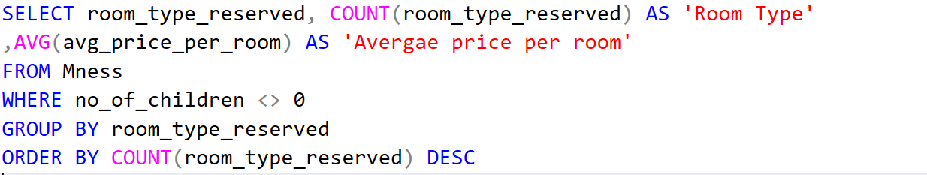
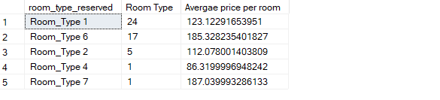
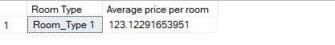
14TH QUESTION
For reservations involving children, what is the most common room type, and what is the average price for that room type?

Slide 18
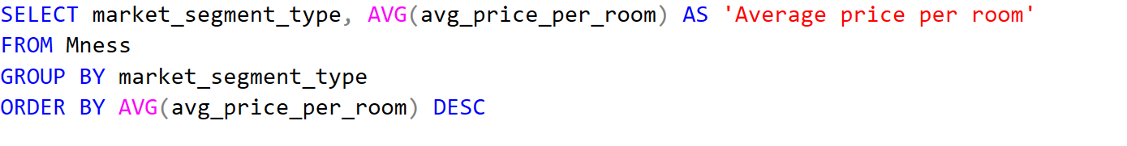
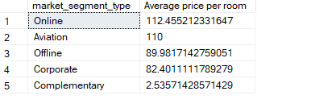
15TH QUESTION
15. Find the market segment type that generates the highest average price per room.
Online is the market segment that generates the highest price per room.

